Slide 1




KI
NEXT GEN EMPLOYABILITY PROGRAM
Creating a future-ready workforce
Team Members
College Name
KINGSTON ENGINEERING COLLEGE-(5113)
Student Name :AKSHAYA.D
Student ID :au511321104004

Slide 2

CAPSTONE PROJECT SHOWCASE
Project Title
Building Bus Reservation System using Python and Django
Abstract | Problem Statement | Project Overview | Proposed Solution | Technology Used | Modelling & Results | Conclusion

Slide 3
ABSTRACT:
This comprehensive project aims to develop a user-friendly, efficient, and scalable bus reservation system using the power of Python and Django. From streamlined booking to seamless management, this system will revolutionize the way travelers plan and execute their bus journeys.
The Bus Reservation System is a comprehensive software solution designed to streamline the process of booking and managing bus tickets for passengers and operators. In an increasingly digitized world, this system provides an efficient and user-friendly platform for passengers to book their bus tickets online, as well as for bus operators to manage their fleet and schedules seamlessly.
The system offers a range of features tailored to meet the needs of both passengers and operators. For passengers, it provides an intuitive interface where they can search for available buses, view schedules, select seats, make payments securely, and receive e-tickets instantly. Additionally, passengers can manage their bookings, make cancellations, and view their booking history conveniently through the system.The Bus Reservation System aims to enhance the overall travel experience for passengers while improving efficiency and profitability for bus operators.

Slide 4
PROBLEM STATEMENT:
Issue: The current bus ticket booking process is cumbersome and inefficient, leading to dissatisfaction among passengers and operational challenges for bus operators. Challenges: Inconvenient booking process: Long queues and reliance on third-party agents. Limited information accessibility: Lack of real-time information on schedules, routes, and seat availability. Booking management complexity: Difficulty in managing bookings, changes, and cancellations. Operational inefficiencies: Manual processes leading to resource wastage and revenue loss for bus operators
This comprehensive project aims to develop a user-friendly, efficient, and scalable bus reservation system using the power of Python and Django. From streamlined booking to seamless management, this system will revolutionize the way travelers plan and execute their bus journeys.
Inefficient Booking Process:Existing systems often have a cumbersome booking experience, leading to frustration and abandoned reservations.
Lack of Real-Time Updates:Passengers struggle to stay informed about schedule changes, seat availability, and other critical information.
Complex Management Challenges:Bus operators face difficulties in managing inventory, generating reports, and making data-driven decisions.

Slide 5
PROJECT OVERVIEW:
The project aims to develop a Bus Reservation System using Python and Django, a popular web framework, to modernize and streamline the bus ticket booking process for passengers while providing efficient management tools for bus operators. The system will consist of two main components: a user-facing interface for passengers to search for buses, book tickets, and track their journeys, and a backend dashboard for bus operators to manage routes, schedules, reservations, and analyze perform.
Streamlined Booking:A user-friendly interface that simplifies the booking process, allowing passengers to easily select routes, dates, and seats.
Real-Time Updates:Passengers will receive instant notifications about schedule changes, seat availability, and other important information.
Comprehensive Management:Bus operators will have access to powerful tools for inventory control, reporting, and data-driven decision-making.

Slide 6
PROPOSED SOLUTION:
.
Customer Booking:
Passengers will be able to search for routes, view available seats, and complete their reservations with ease.
Real-Time Updates:
The system will provide instant notifications to passengers about schedule changes, seat availability, and other crucial details.
Operator Management:
Bus operators will have access to comprehensive tools for inventory control, reporting, and data-driven decision-making.

Slide 7


TECHNOLOGY USED:
Front-end
Back-end

Slide 8
MODELLING AND RESULTS:
Data Modeling:
The system will utilize a robust data model to handle information about routes, schedules, passengers, and reservations.
User Interface:
A clean, intuitive, and responsive user interface will be developed using Django's powerful web framework.
Backend Logic:
The backend will be built with Python, leveraging Django's features for efficient data management and processing.
Deployment:
The system will be deployed on a scalable cloud platform to ensure high availability and easy maintenance.

Slide 9
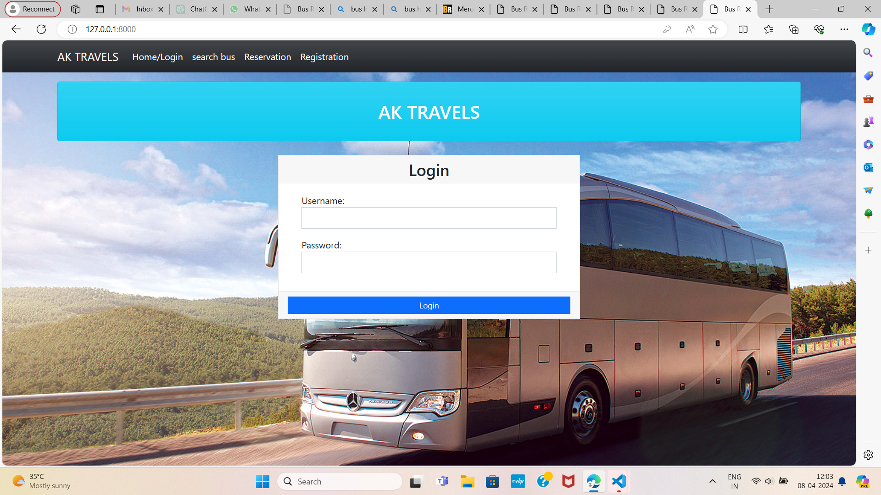
HOME PAGE

Slide 10
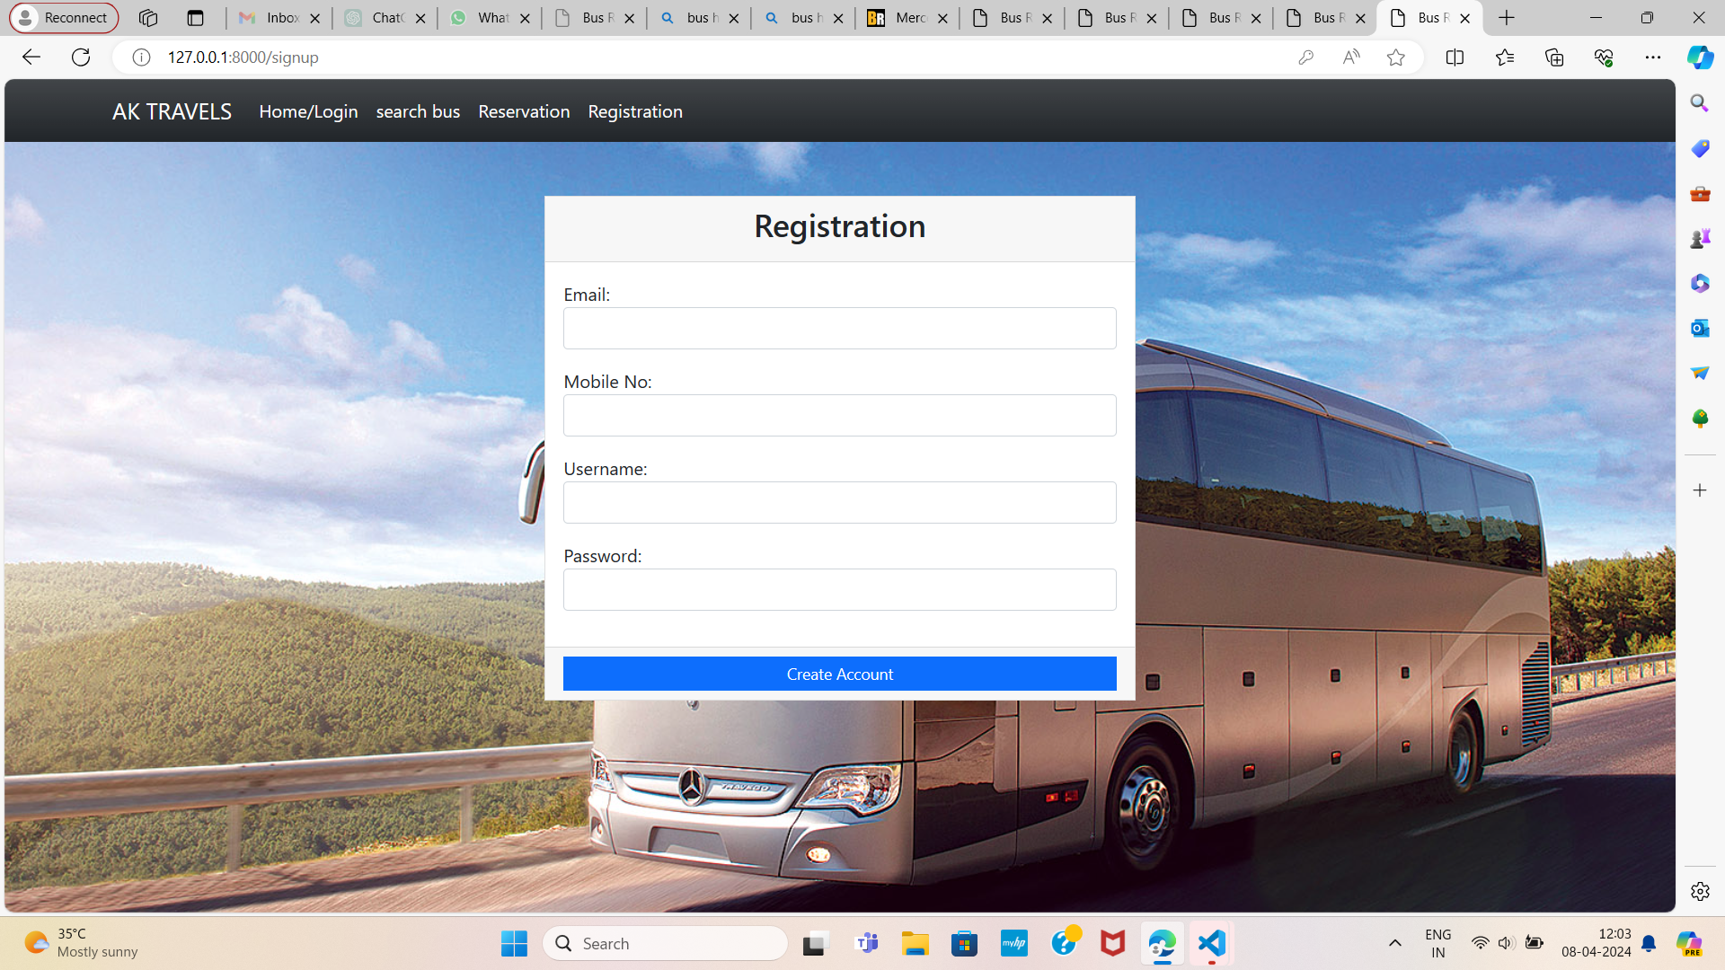
ABOUT-US-PAGE

Slide 11
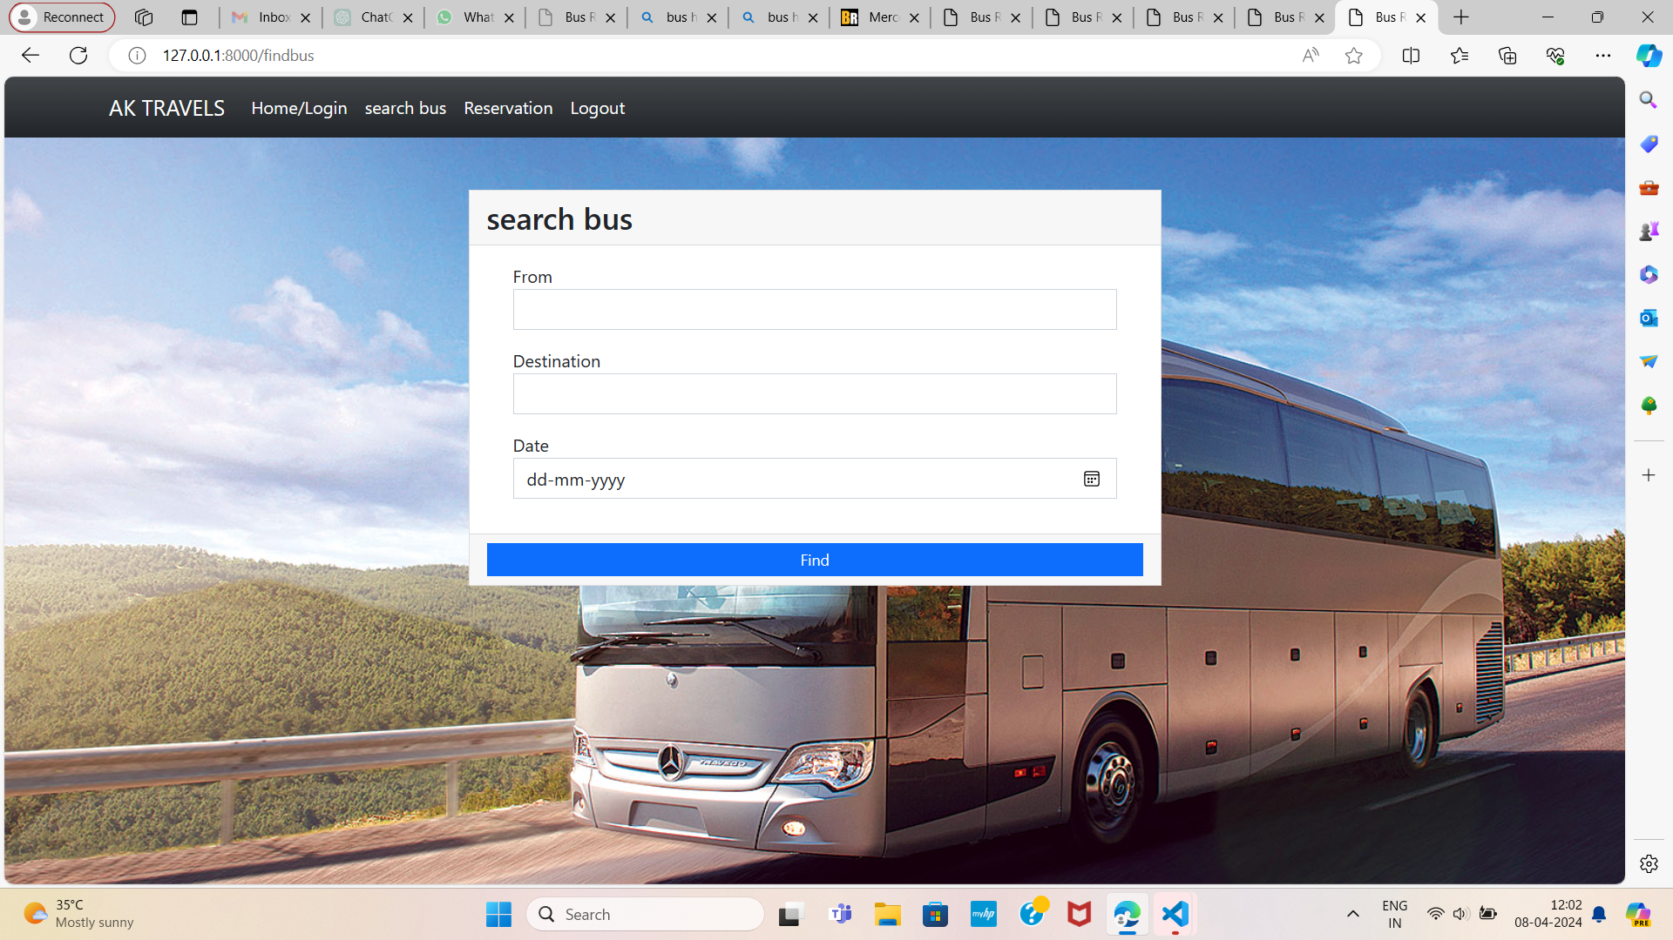
SERVICE-PAGE

Slide 12
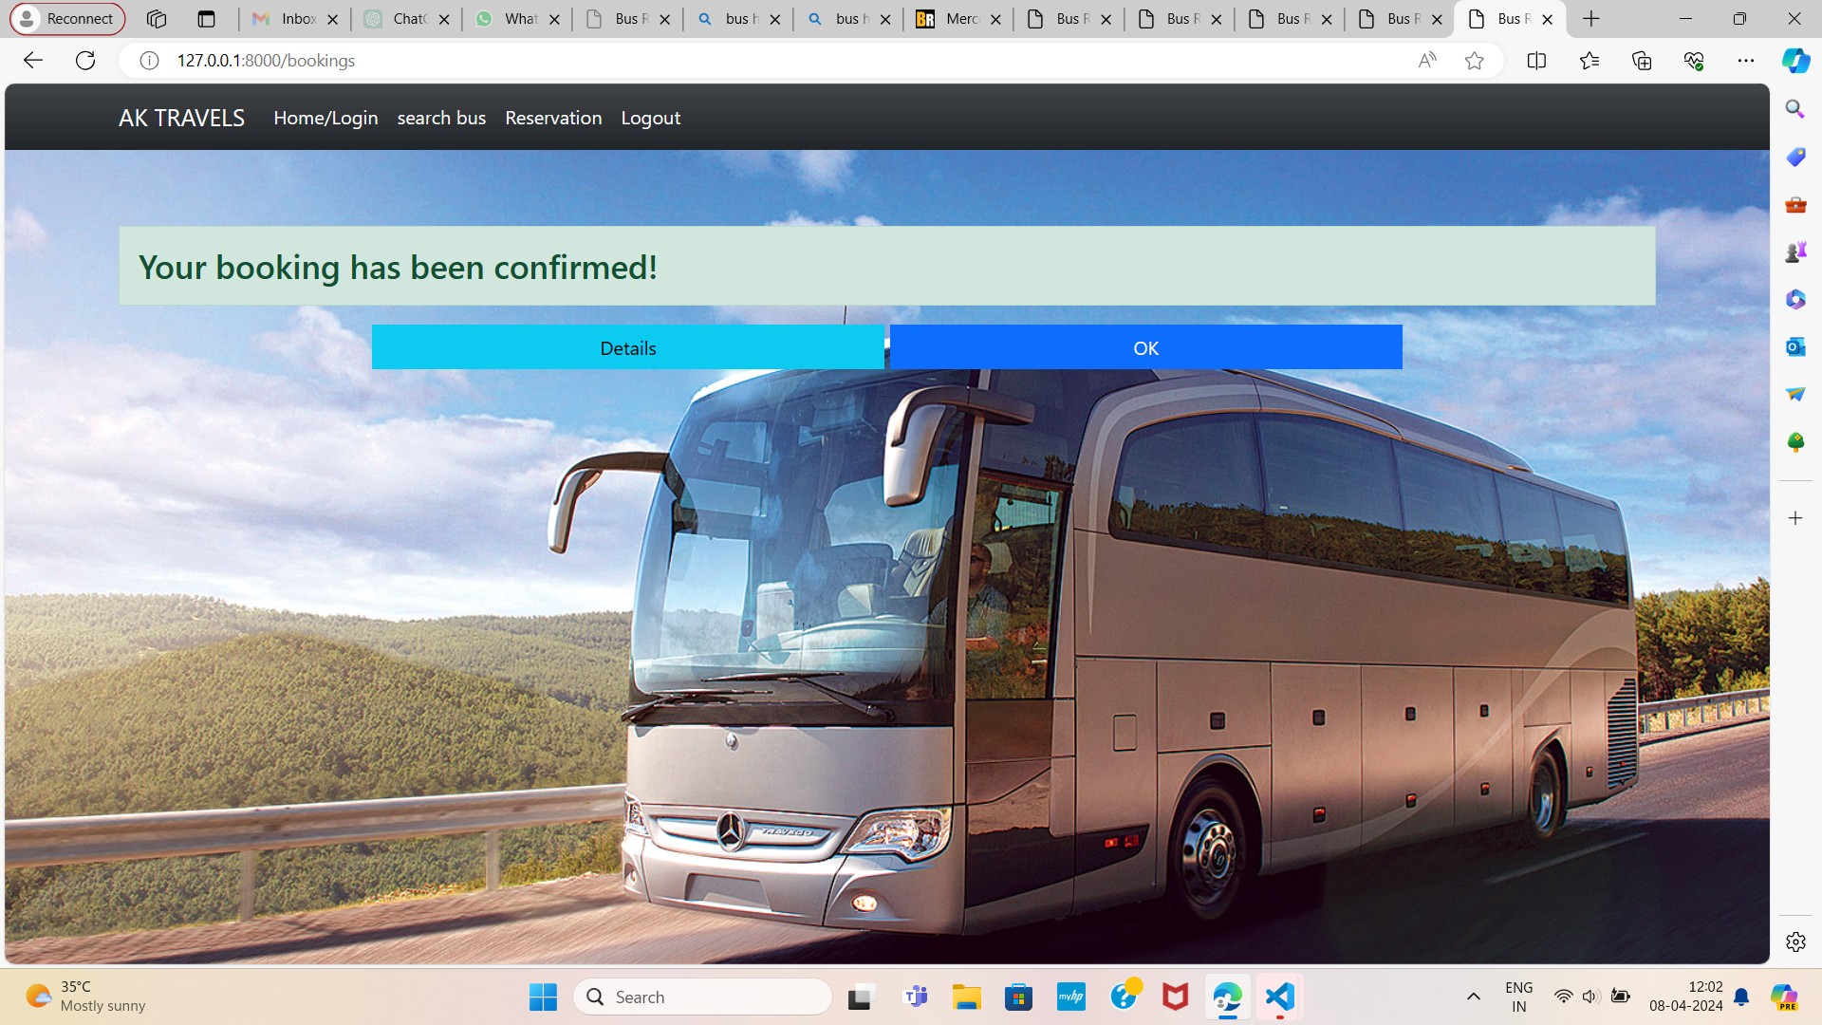
DEPARTMENTS-PAGE

Slide 13
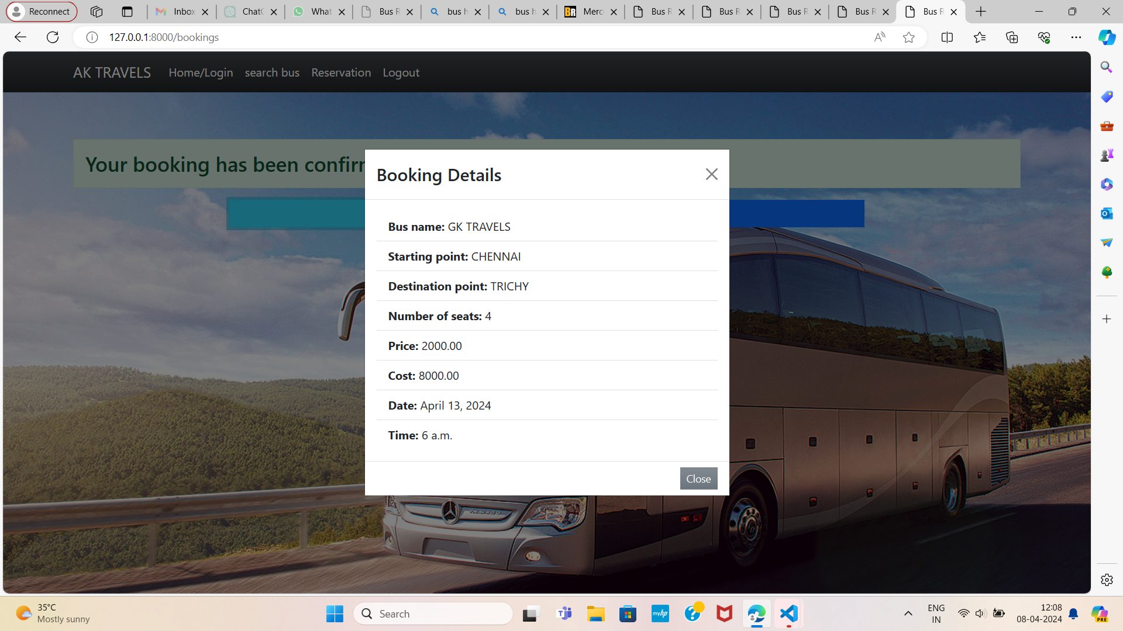
BOOKING DETAILS

Slide 14
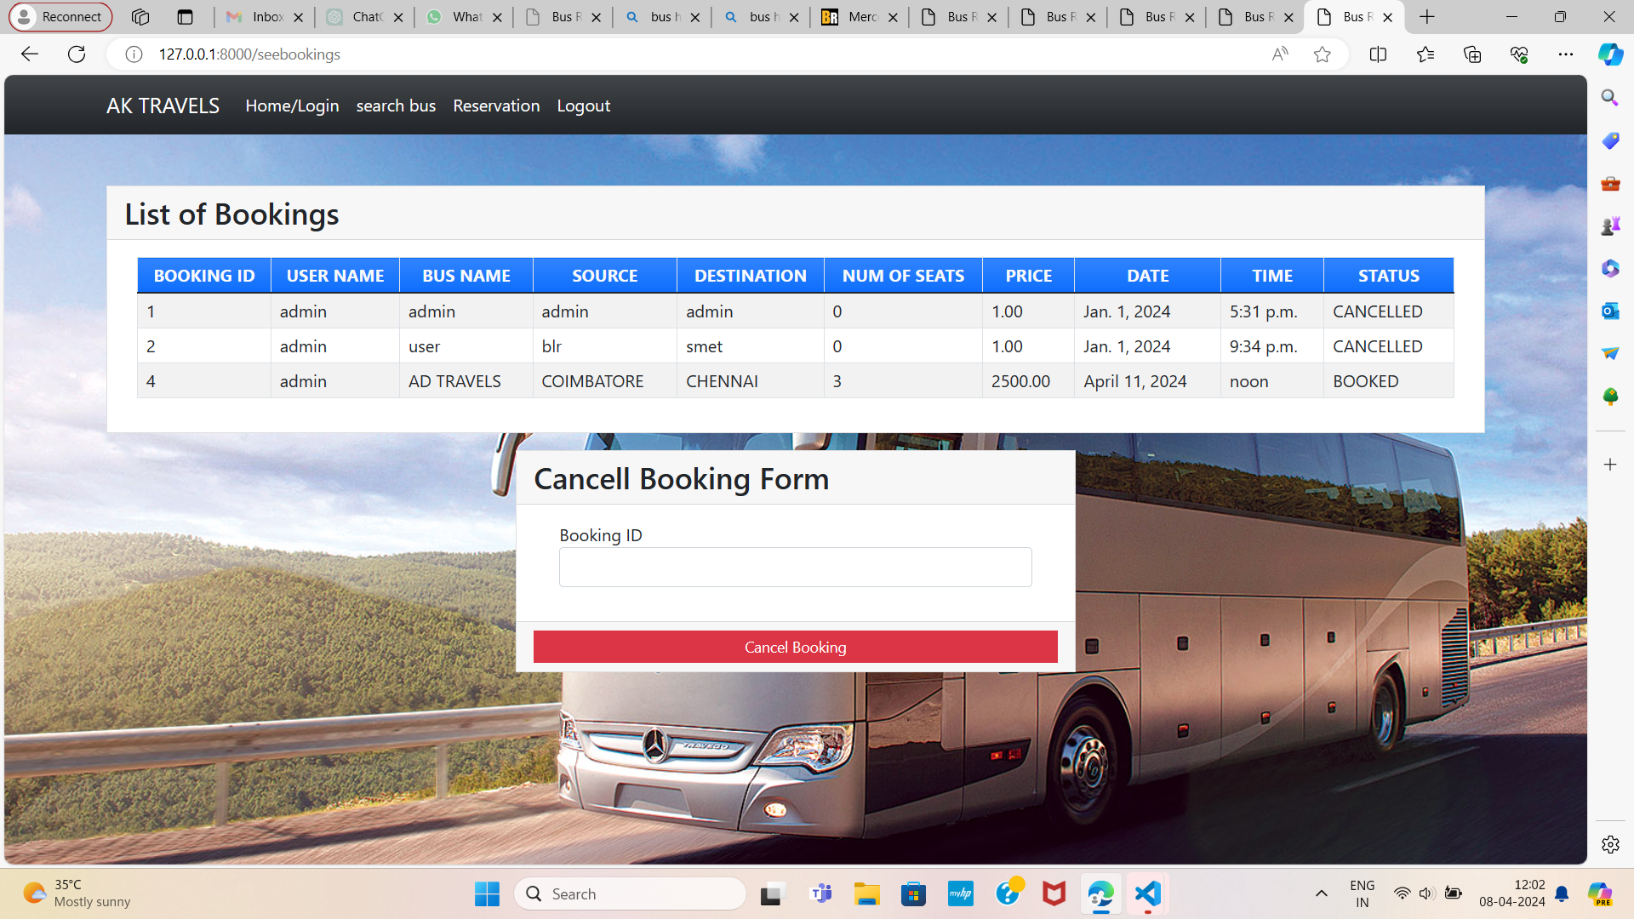
BLOG-PAGE

Slide 15
FUTURE ENHANCEMENT:
Mobile App:
Develop a mobile app for seamless booking and real-time updates on-the-go.
Advanced Analytics:
Implement data-driven insights to optimize routes, schedules, and pricing strategies.
Integrated Ecosystem:
Integrate the system with other transportation services for a comprehensive travel experience.

Slide 16
CONCLUSION:
Streamlined Booking:
A user-friendly booking process that enhances the passenger experience.
Real-Time Updates:
Keeping passengers informed and empowered throughout their journey.
Comprehensive Management:
Equipping bus operators with the tools to optimize their operations.
By harnessing the power of Python and Django, this bus reservation system will revolutionize the way travelers plan and execute their journeys, while providing bus operators with a robust and data-driven management solution.

Slide 17
Thank You!
Notes:
Thank You !!

